Slide 1


Photosensitive Epilepsy in UI Design
The Challenge: Photosensitive epilepsy is a condition where seizures are triggered by flickering lights, high-contrast patterns, or specific frequencies of visual stimuli.
The Impact: In digital environments, this poses a "safety-critical" challenge for UX/UI designers who must actively avoid creating hazardous visual content.

Slide 2

3-30Hz
Rapid changes in luminance or color intensity operating between 3Hz and 30Hz are the primary triggers found in autoplay videos and flashing digital ads.
The Danger Zone

Slide 3








Research: Harding & Harding (2010)
Critical Frequency
Three Flashes Rule
User Agency
The research clearly identifies the 3Hz to 30Hz range as the highest risk zone for inducing seizures in users.
A core guideline establishing that absolutely no part of the screen should flash more than 3 times in any given second.
The study strictly emphasizes that dynamic web content must include accessible, user-controlled toggles to disable movement.

Slide 4
Avoid the Avoidable
Always disable autoplay by default. Allow users to initiate movement manually to avoid unexpected and dangerous visual triggers.

Slide 5





Research: Fisher et al. (2005)
Luminance Impact
Screen Area Correlation
Technical Safeguards
Researchers found that the harshness of brightness transitions is just as dangerous as the frequency of the flashes themselves.
The study proposed the mandatory use of automated scanning tools to detect hazardous visual sequences during UI development.
The seizure risk increases significantly if the flashing content occupies a large percentage (>25%) of the user's field of view.

Slide 6

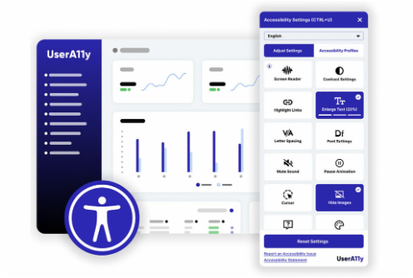
Case Study: accessiBe UI Overlay
Seizure Safe Profile A dedicated, user-activated mode designed to neutralize visual hazards instantly across the entire interface.
Real-Time Filtering Acts as a real-time filter between raw web content and user perception, ensuring strict compliance with safety standards.
Freeze Motion Technology Immediately pauses all GIFs, CSS animations, and looping videos with a single toggle, returning control to the user.

Slide 7
Designing for epilepsy improves UX for everyone by reducing visual noise and creating more intentional interactions.
"
"
THE UNIVERSAL BENEFIT OF SAFE DESIGN

